Slide 1

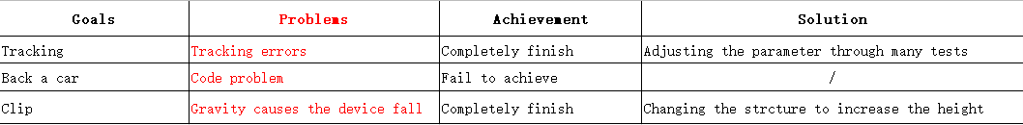
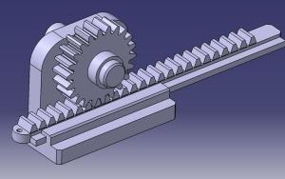
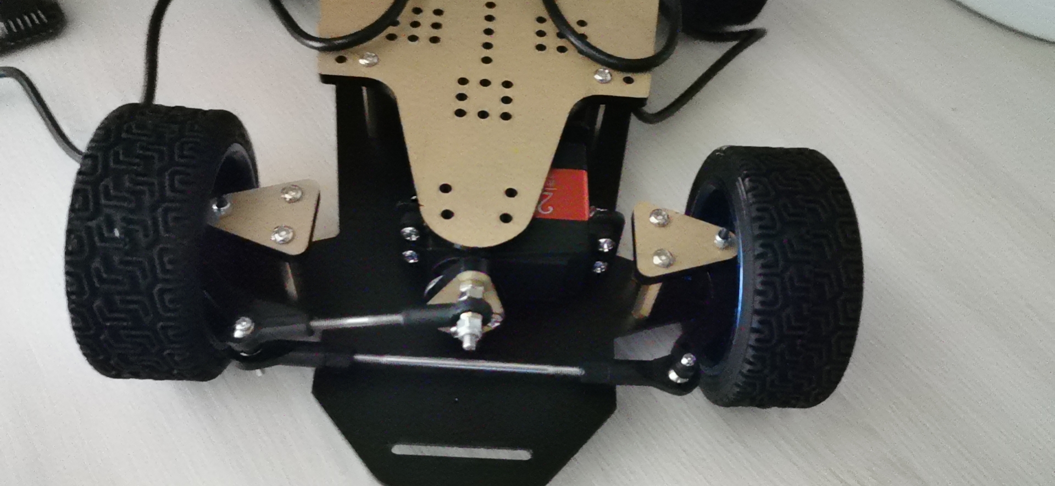
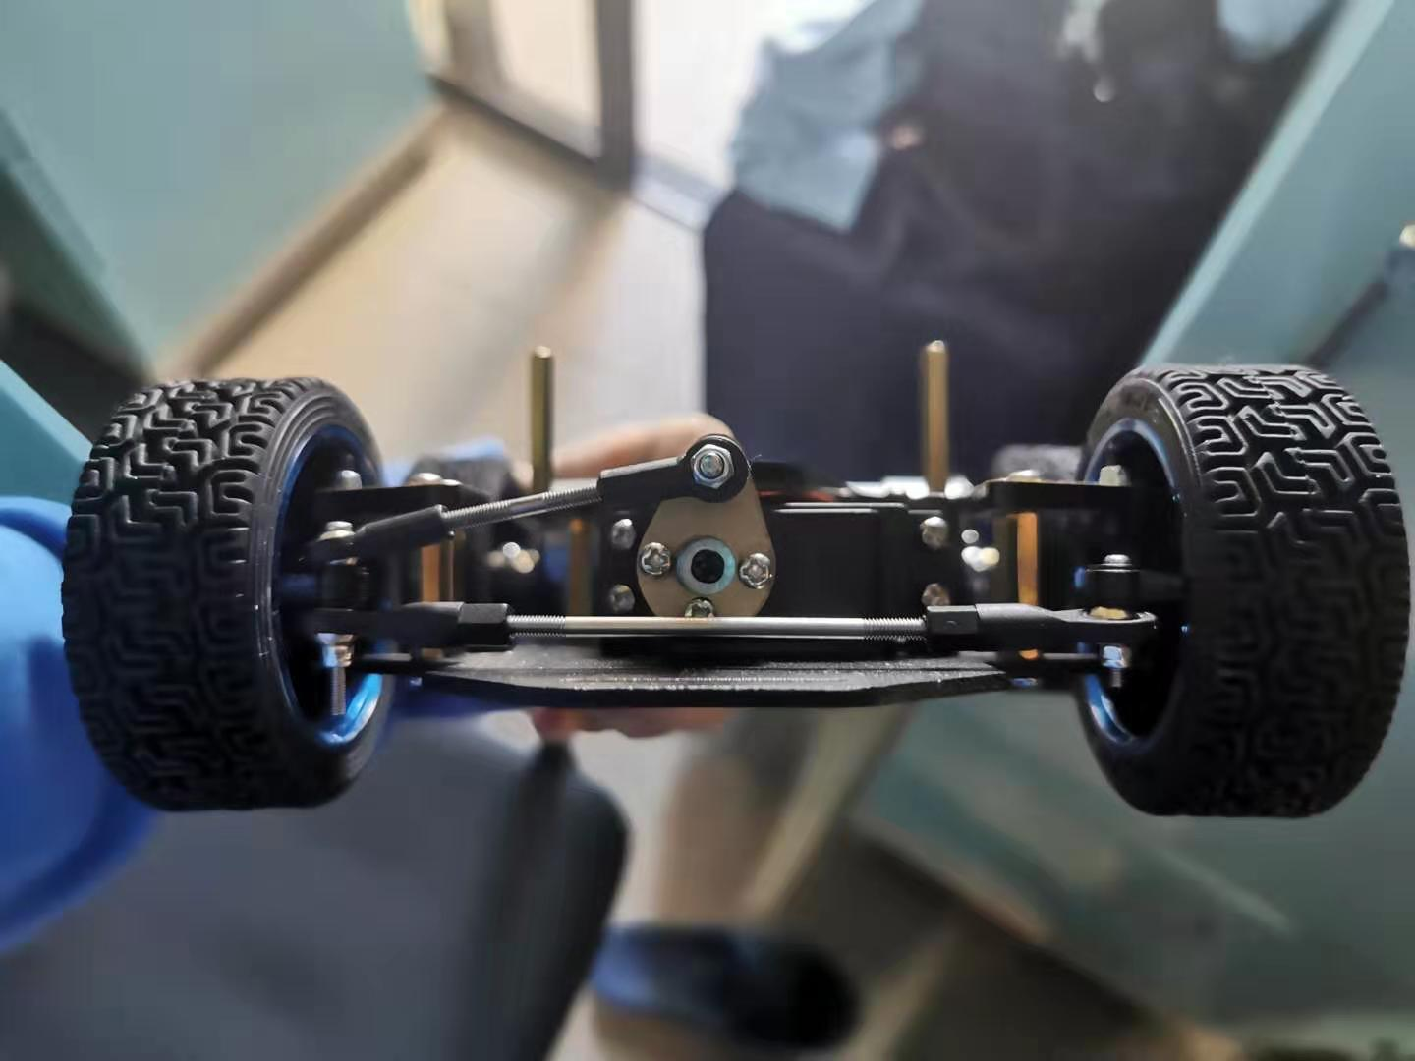
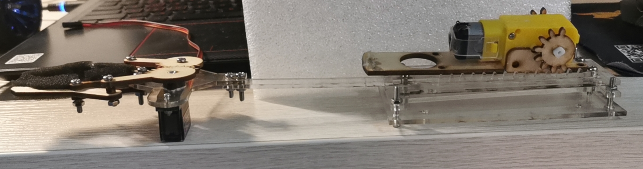
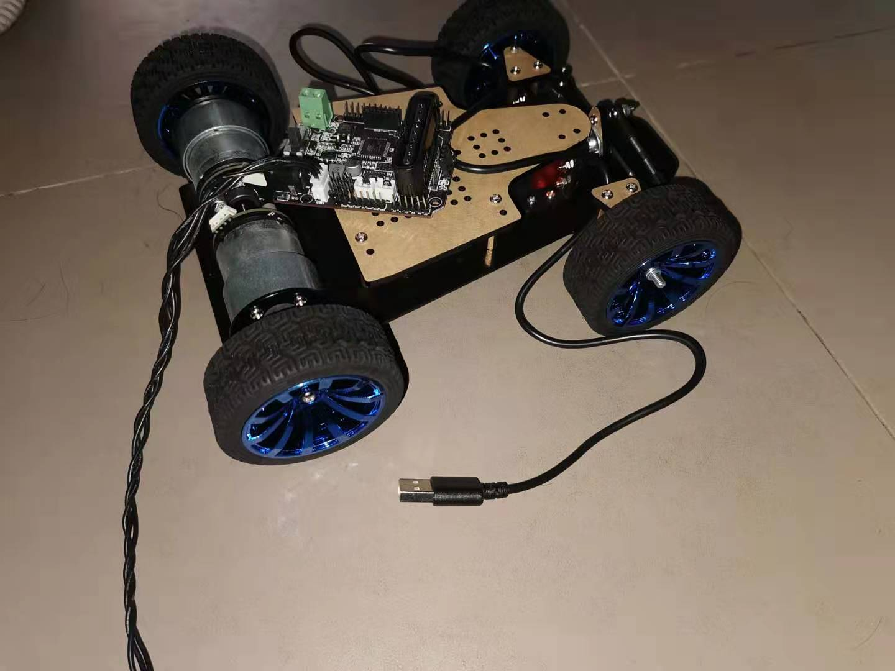
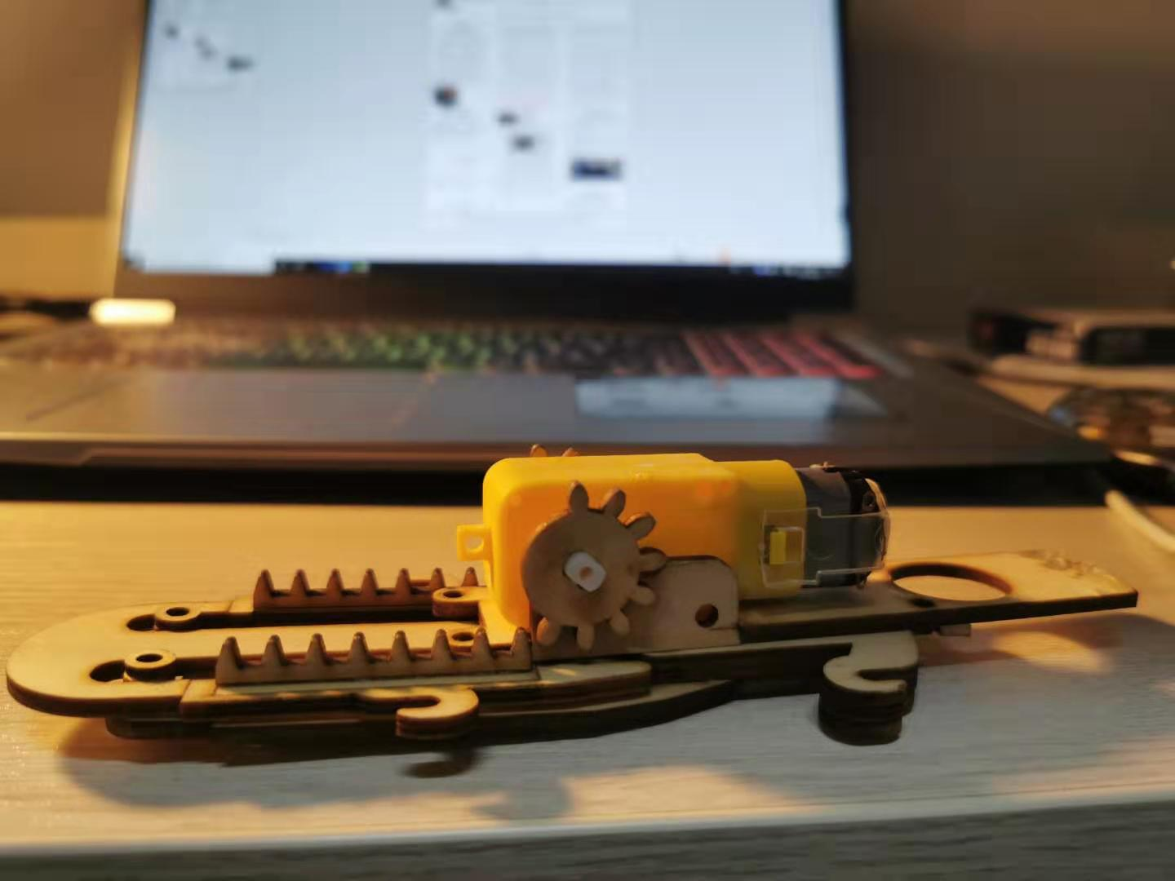
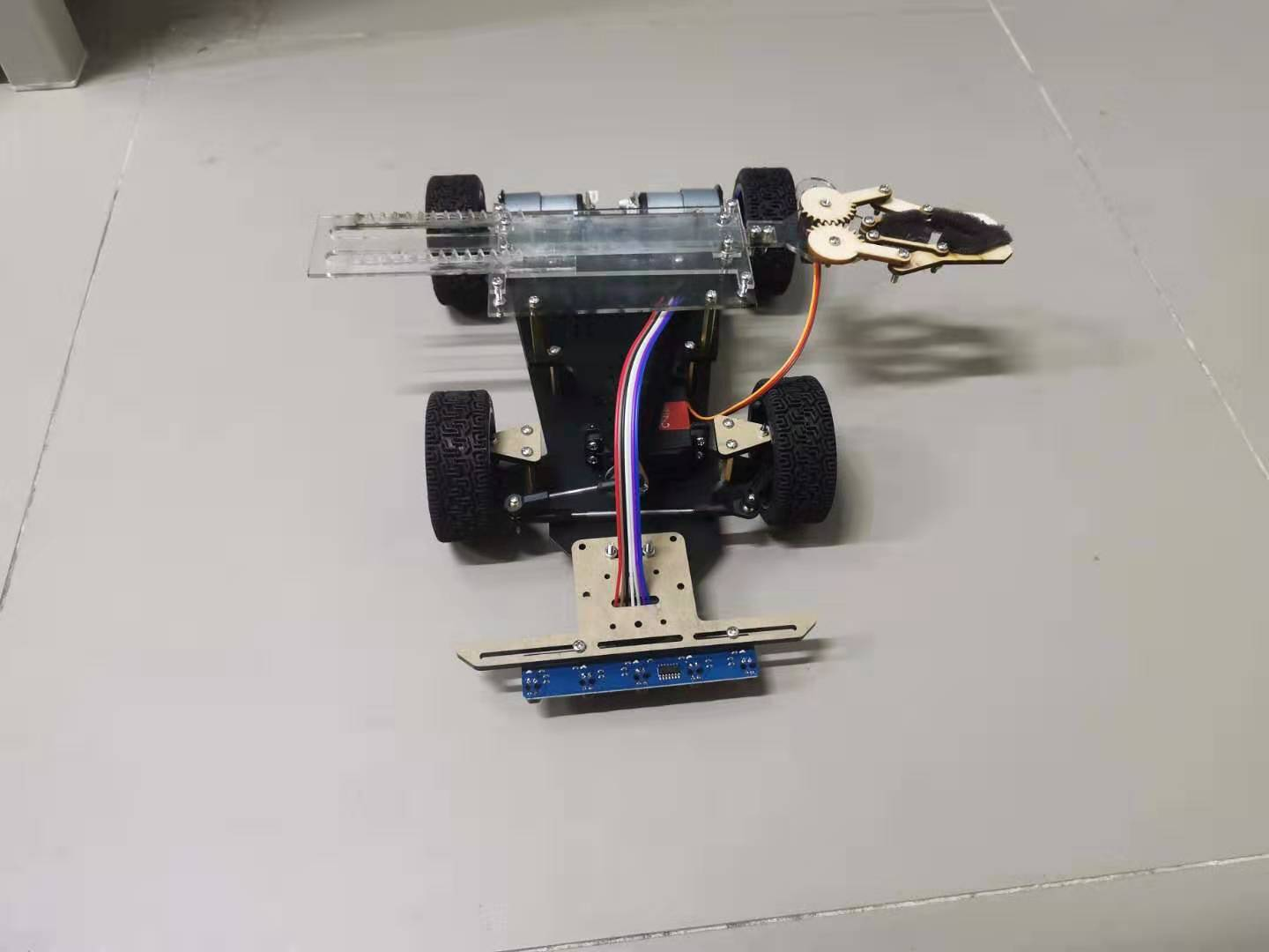
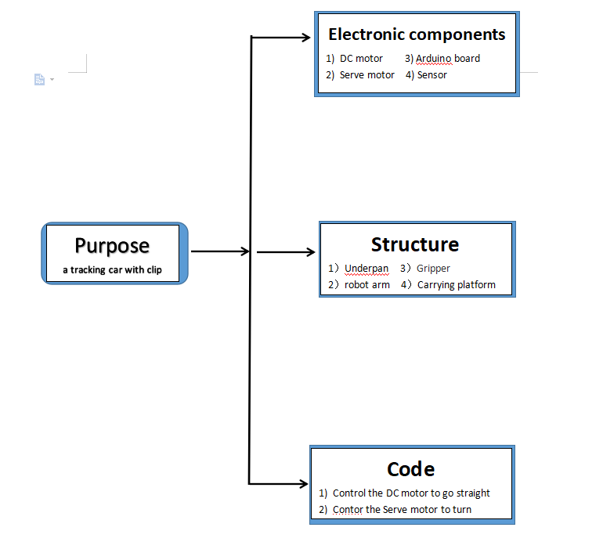
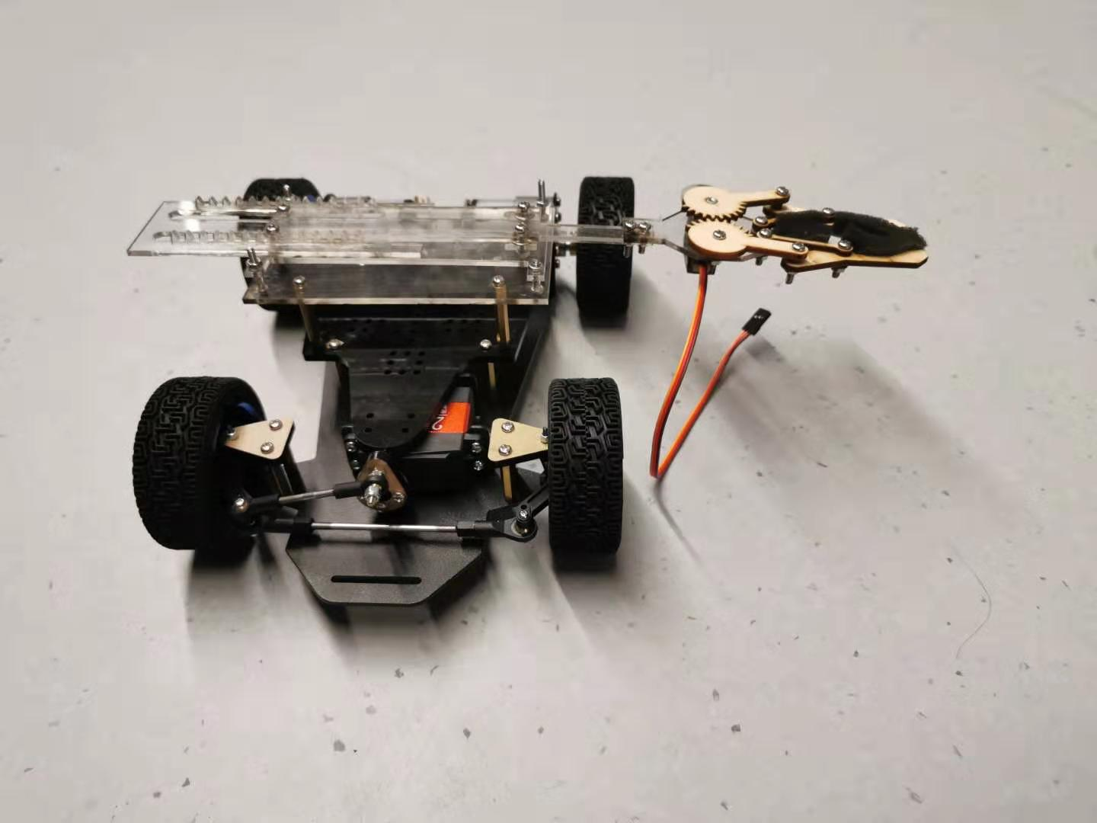
Cargo robotic car
Team Member (YuChen Liu, LuoChuan Zhang, XueWen Wang, Yuchen Song, Wei Yan)
Instructors (Yong Zhong, Shaofeng Lu)
Introduction
Procedure and Results
Discussion and Analysis
For robots, robotic cars are definitely the most stable and easiest to make. So we want to design a tracking car with grip function. And in this expo competition, the speed must be the most important factor, so the car need to use wheels and one freedom grip device can be more fast to finish picking than more freedoms.
There are somenthing we want to achieve and some problems we come across.
1) When we disscuss to design a new car, we have meet a problem that using Servo motor to turn or using differential speed to finish turning. And after analysis, we found that the use of the Servo motor can make the steering more stable and fast.
2) A complex structure for a grip device may be cool, but in this competition, we need to improve our car's velocity, so one freedom grip device is better.
The combination of gear and rack allows the arm to move forward and backward
Transmisson sructure
Servo motor
The shaft ensure the two wheels are in sync when they are in motion
Methodology
Car
Grip Device
Conclusions
Use Arduini board to receive the signals from sensor and control the DC motor to make car go straight and control Serve motor to make a turn. And make a grip action when a special signal is detected.
1) Using differential speed to finish turning can make car shake, so using Servo motor is more stable
2) With the gear drive, we can stretch the arms forward and backward using only the dc motor
Robotic car
Acknowledgement
For this robotic car, we apply the principle of Automotive steering. Using many shafts and bearings to ensure the car can move smoothly. The transmission structure is very delicate, we just use DC motor to finish griping
References
1) WANG Yongding, 2010, Machine Tool ＆ Hydraulics, No.14 (2010), pp.75-78.

